Slide 1
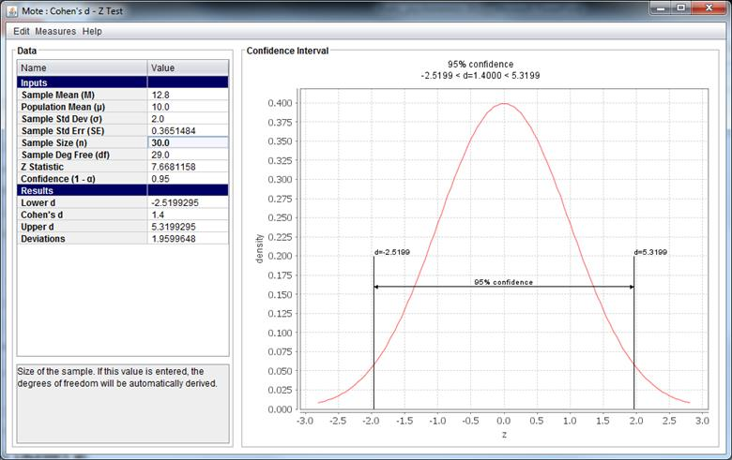
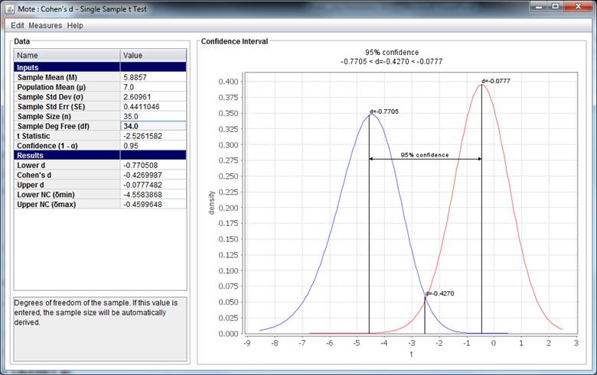
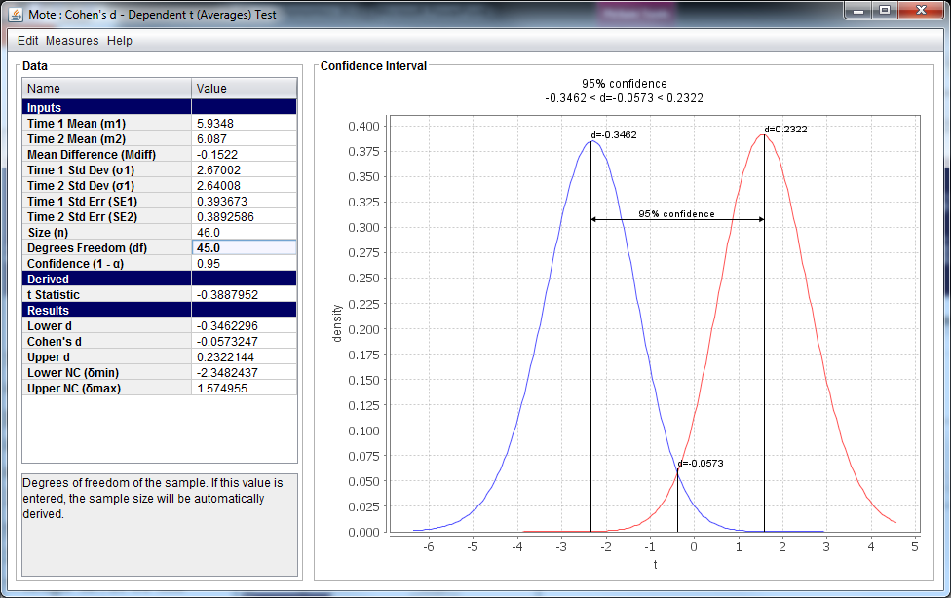
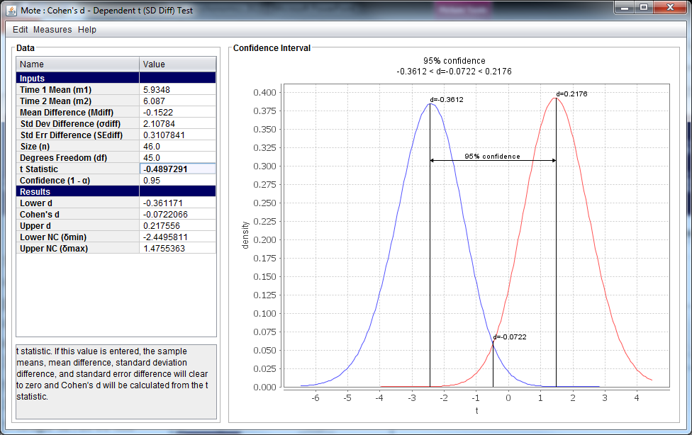
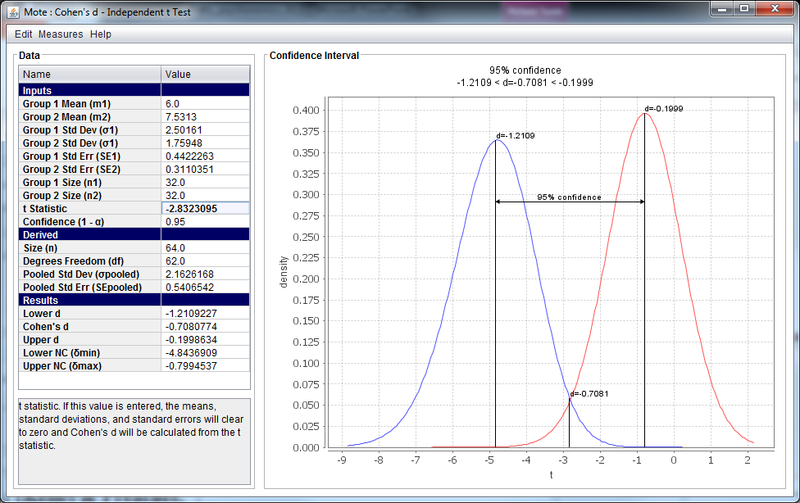
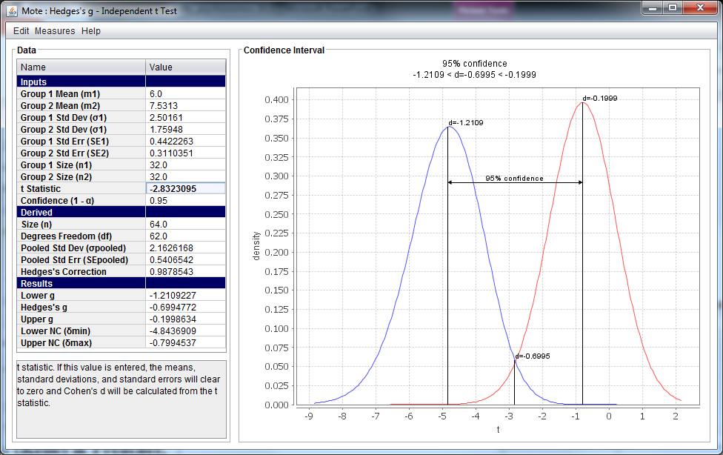
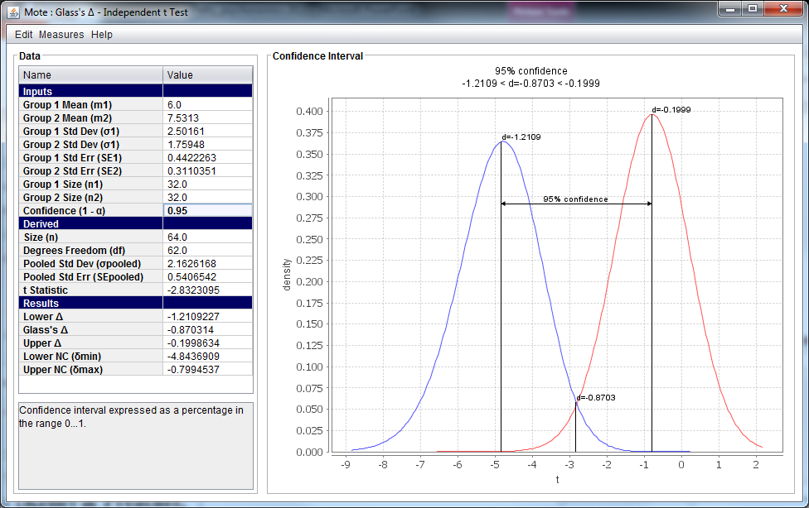
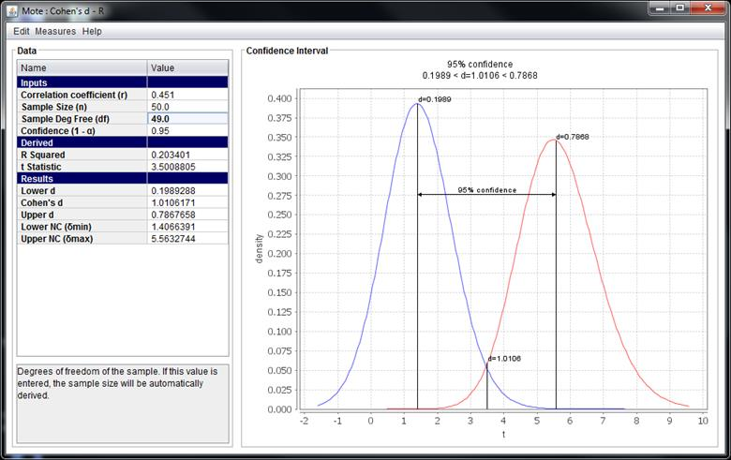
Effect Sizes Should Be Easy: Introducing MOTE: Measure of the Effect
Erin M. Buchanan, Kathrene D. Valentine, Carrie Melia, Cory J. Derringer Missouri State University
Abstract
This presentation will outline a new free effect size program that was developed to calculate various effect sizes, Cohen’s d, ω, η², r/R², φ, f, and odds-ratios, and their corresponding confidence intervals. We have included options for users to calculate from information traditionally provided in journal articles (for power or meta-analyses) or output from statistical analyses programs like SPSS. Users can navigate by selecting an effect size or the statistical test performed (such as independent t), which provides flexibility depending on the goals and knowledge level of the user. Recent publications on the “replication crisis” have shown that effect sizes and their confidence intervals can give us powerful insight into the potential file drawer of a study, as well as the ability to examine if an effect is consistent with a particular size. Development and applications of the program will be discussed.
Z-Test
Meta-Analysis Example
Single Sample t-Test
Dependent t-Test
Using the Average Standard Deviation
The Importance and Problems of Effect Sizes
The APA Task Force and publication manuals strongly encourge the use of effect size reporting (1999, 2001, 2010).
Current report rates are mixed: clinical sources (40%), non-clinical sources 70% (Fritz, Scherndl, & Kühberger, 2013)
What are effect sizes?
Measure of strength of a phenomenon.
Strongly related to power of an experiment.
What are the components to effect sizes (Kelley & Preacher, 2012)?
Effect size dimension: finding a way to quantify variance in standardized units.
Effect size measure or index: formulas used to calculate different effect sizes.
Effect size value: specific value from an experiment.
Currently available options:
SPSS/SAS calculate some options (η_{p}² , R²).
Wepages (Soper, 2013; Becker, 2000).
Macros (Wilson, 2010; Smithson, 2003).
MBESS plug in for R (Kelley … ).
Why aren’t we reporting them?
Formulas are variable depending on sources, making effect size selection difficult.
Most options are not flexible for the user.
Macros, R plugins require more advance knowledge set.
Confidence Intervals
Reporting CIs for effect sizes is useful for meta-analyses, power, and to discuss the “replicability crisis”.
CIs are based on non-centralized distributions (Smithson, 2003; Cumming & Finch, 2001; Kelly, 2007) which required iterative calculus.
Dependent t-Test
Using the Standard Deviation of Difference Scores
The effect size and corresponding confidence intervals were calculated for 39 tests found in five research articles focusing on Judgments of Learning research from John Dunlosky’s lab.
As can be seen by the above forest plot, the majority (33 tests, 85%) of tests found effect sizes that did not cross zero, however a few (6 tests, 15%) did cross zero.
Independent t-Test
Discussion
Hedge’s g for Independent t-Test
The beta version of MOTE is free for download at http://www.aggieerin.com/stats/.
MOTE was designed to be intuitive for all levels of users.
Feedback is requested through the survey linked on website.
Graphics are modifiable and savable for future use.
Confidence intervals are customizable for specific user preference.
Future updates include effect sizes for ANOVA, regression, chi-square, odds-ratio studies, and fit indices.
Suggested uses include experimental analyses, meta-analyses, and application as a pedagogical tool for teaching statistics.
Glass’s Δ for Independent t-Test
Contact
Correlation
Download: http://www.aggieerin.com/stats/
Corresponding author: erinbuchanan@missouristate.edu
Corresponding author: katy.valentine3@gmail.com
Programmer: Tim Larmer tim@tlarmer.com
http://www.tlarmer.com/

